Slide 1
SINHGAD INSTITUTE OF MANAGEMENT
PUNE – 411041
MCA-III Sem-VI
Face Recognition Based Attendance System
(Website)
By
Mr. Vrushabh Hanmant Lnadage - 353
Guide Name : Prof. Rahul Navle

Slide 2
Introduction:
For every organization, today attendance is the most important thing to record the presence of employee. The presence of employee in an organization is a sign that the person is carrying out their obligations to come to the agency or organization. Usually, attendance is done manually. It can be signed or called one by one. We can use face recognition to record attendance from everyone. In this face recognition, many algorithms are performed to detect face of employee. The system can recognize a person's face and record attendance from that person so that attendance activities are more efficient and faster

Slide 3
Existing System and Need for System
Speaking about manual attendance systems, these are traditional systems that require employees to fill in their attendance sheets manually. These are generally used by small scale companies where there is less number of employees. However, such attendance systems require fair and consistent execution. Besides, HR managers face enormous pressure when it comes to collecting details about employees’ working hours with these systems. For better understanding, let’s have a look at the pros and cons of such a system.

Slide 4
Operating Environment-
Hardware :
Processor : Core I7
RAM : 8GB ram
Hard disk driver : 256GB SSD
Keyboard : 104 keys
Mouse : Logitech Mouse
Monitor : Laptop
Display Type : LCD
Software:
Operating System : Windows 10 (Home Basic)
Designing Tool : Pycharm
Frontend : Python, Streamlit Framework
Backend : sqlite

Slide 5
Advantages:
Easy to operate.
Quick access to records.
Display records of selected date.
Less time consuming.
Manage Image data.
Increase the efficiency of managing Records.

Slide 6
Disadvantages:
This application can’t differ between photo and actual person.
There is no any alternative method provided when it fails.

Slide 7
Module Specification
• Image Upload (Gathering data):
The first module in Face recognition based attendance system is ‘image upload’. In this module user upload image data with name as first four letter as identity number and followed by his name like “0001Vrushabh”. User can also able to see what data he or she is uploaded on the website.
• Image Encoding (Process data):
The second module in Face recognition based attendance system is ‘image encoding’. In this module, system extract image data and store for comparison with image data getting from camera while detecting and marking attendance.
• Face Detection and Recognition:
The third module in Face recognition based attendance system is ‘Face Detection and Recognition’. In this module system detect the face from camera input and extract the features rom it and compare it with available image data which is uploaded in images folder and if it matches with one of them then system will recognize the face on camera and show message and mark the attendance with current time stamp.
• Attendance Report:
The first module in Face recognition based attendance is ‘Attendance Report’. In this module user can view attendance in tabular format of selected date in given checkbox.

Slide 8
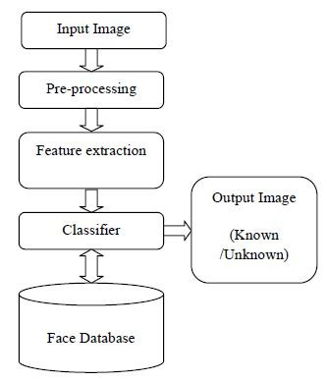
Block diagram

Slide 9
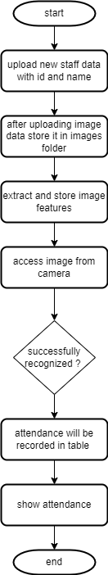
Flowchart

Slide 10
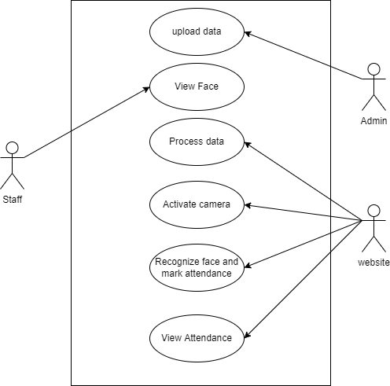
Use Case Diagram

Slide 11
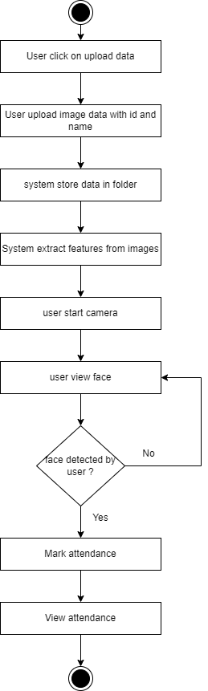
Activity Diagram

Slide 12
Data Table
Name | Data type | Key | Description
Id | Integer | Not Null | Date of trading day.
Name | Text | Not Null | Highest value of that day.
Date | Date | Not Null | Date of Present.
Time | Time | Not Null | Time of Present.

Slide 13
Data Dictionary
1.Id
ID is identification number of Employee which is taken by slicing first four-digits of employee image data provided by user. Datatype of date is INTEGER.
2. Name
Name is name of Employee which is taken by slicing from fifth character from name of employee image data provided by user. Datatype of date is TEXT.
3. Date
Date is date on which presence of employee recorded. Datatype of date is DATE
4.Time
Time is time on which presence of employee recorded. Datatype of date is TIME.

Slide 14
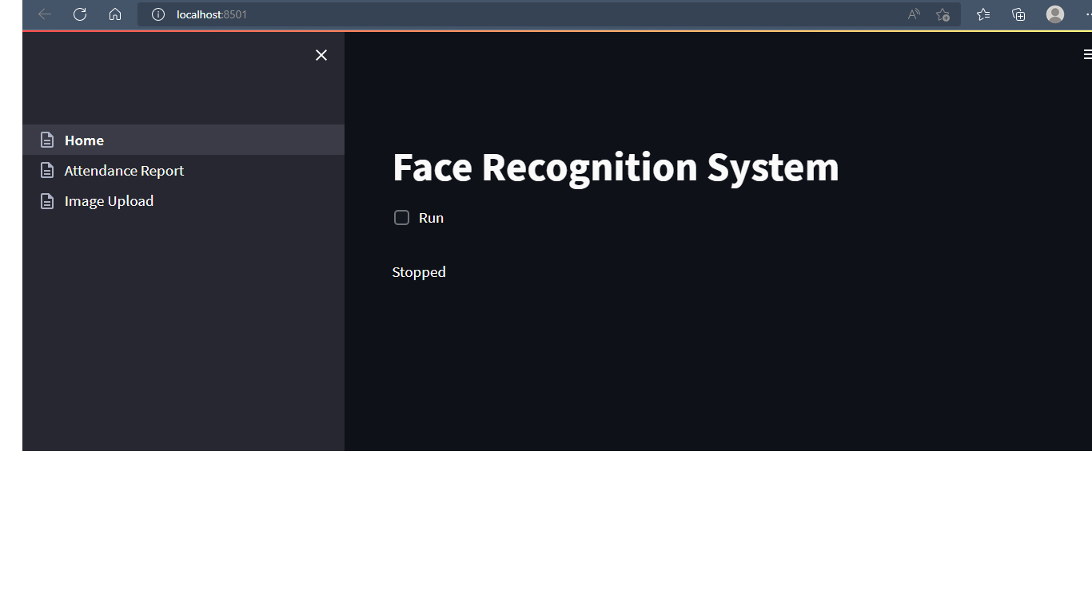
Input / Output Screens Home

Slide 15
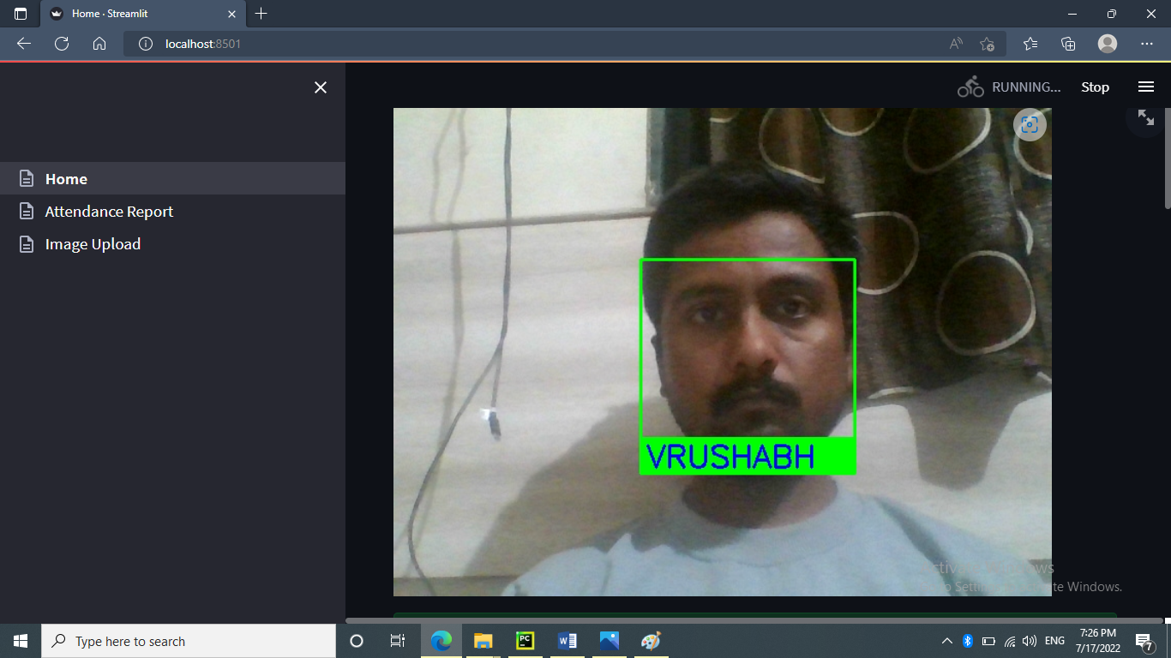
Face Detected

Slide 16
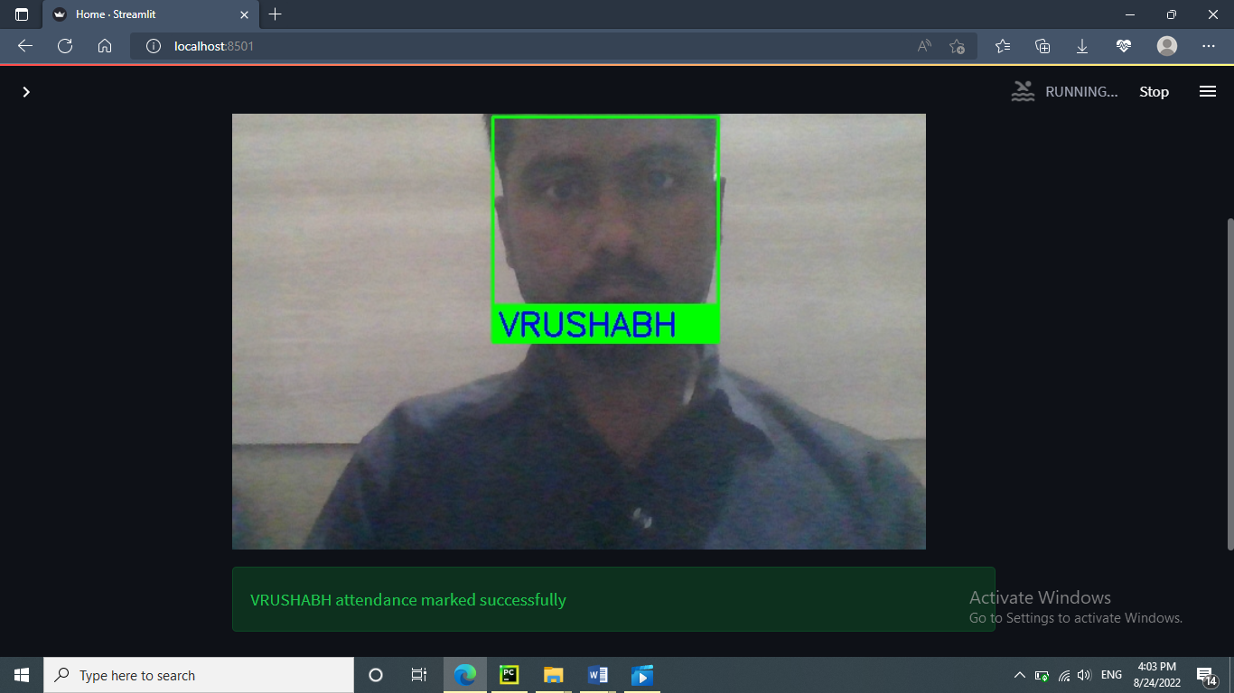
Attendance Mark

Slide 17
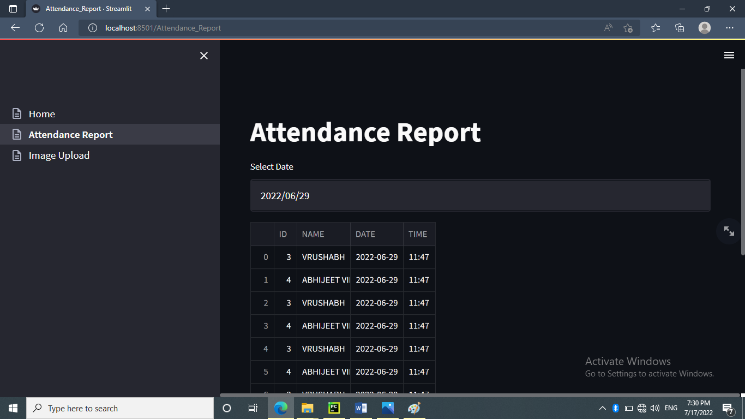
Attendance Report

Slide 18
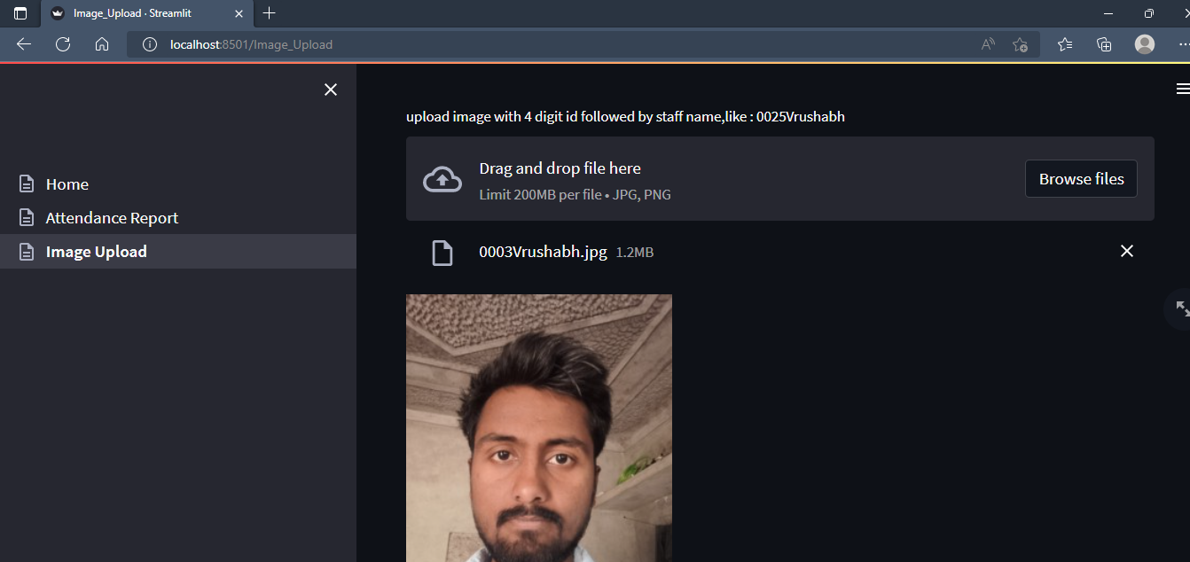
Image Upload

Slide 19
Limitations and Bibliography
Limitations
1. This application can’t differ between photo and actual person.
2. There is no any alternative method provided when it fails.
Bibliography
1. www.stackoverflow.com
2. www.w3schools.com
3. https://docs.python.org
4. https://docs.streamlit.io
5.https://www.youtube.com

Slide 20
Thank You…!

